Slide 1
Electronic Medical
Record
Akshaya Suresh
Krupa Shankar
Niranjhani Vasudevan

Slide 2

WHAT IS MEDICAL RECORD ?
A Medical Record is a record that an hospital maintains after every treatment, every visit to the hospital.
It contains the history of the patient collected in a place.
USE OF MEDICAL RECORDS
To document the course of patient’s illness
& treatment.
Communicate between attending
doctors
and other health Care professional providing care to the patient
Collection of health Statistics.
Insurances Cases

Slide 3
PROBLEM STATEMENT
Maintaining a manual record of data for every person is a hassle. If it is lost then the loss is irrecoverable.
Medical reports in bits and pieces might not be very useful.
Some private hospitals maintain a record only for their patients and are only used for reference when the same patient visits again.
Duplication of same data

Slide 4
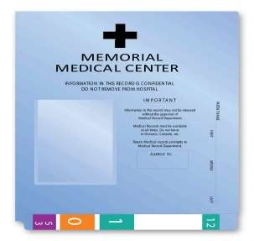
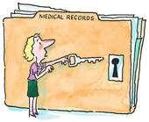


APPROACH
A unique ID is given to a person and with this ID the medical history of the person can be accessed across all the digitalized hospitals, pharmaceuticals and banks
Unique ID for the person is randomly generated and it identifies the person uniquely.

Slide 5
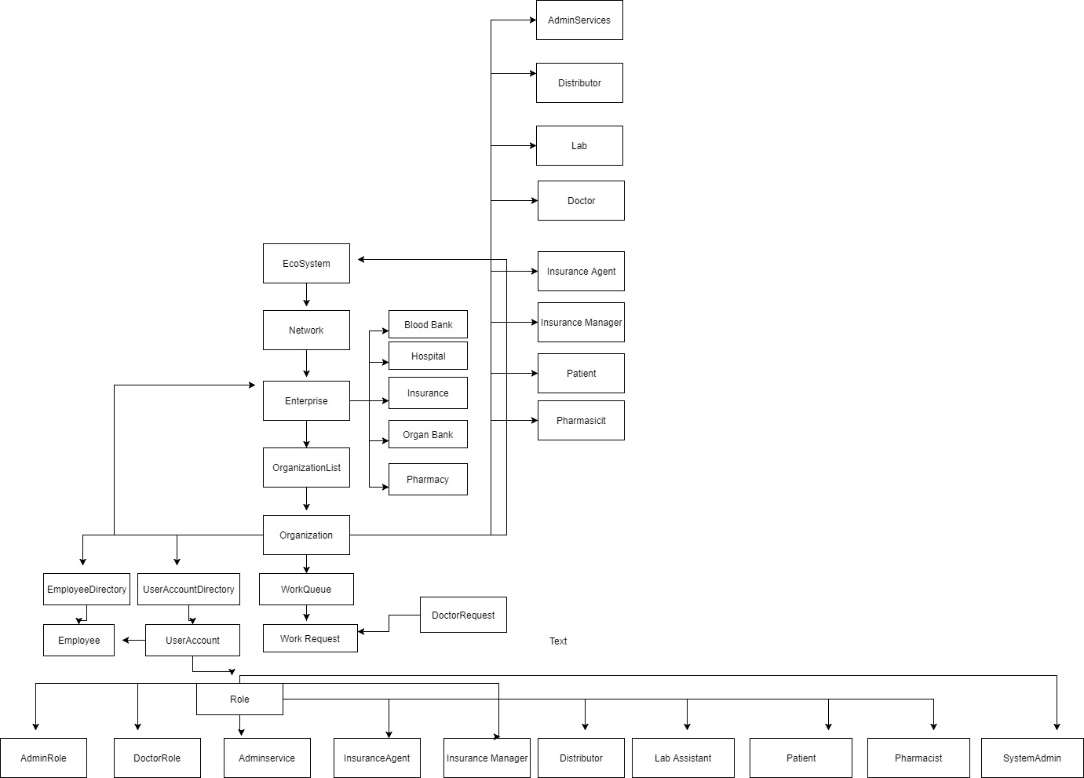
OBJECT MODEL

Slide 6
USE CASE INCLUDED
Storing basic medical records of the patient which includes vaccine, organ, blood test, prescription etc
Sending location details to contact numbers registered in case of emergency
Patient view to edit profile, view medical reports
Patients to view all notifications from Doctors, Blood Banks , Organ Banks.
Finding an organ for transplant
Producing Medical Insurance claim supporting documents

Slide 7
USE CASE INCLUDED
Doctor seeks permission from user to access his/her medical records.
Doctor fills prescription based on the patients issues.
In Emergency mode, Doctor should send his location to the emergency contact via E-mail.
Blood bank org sets up a campaign and sends request to patients registered in it.
Adds the blood obtained from the Campaign to the Blood Bank Inventory.

Slide 8
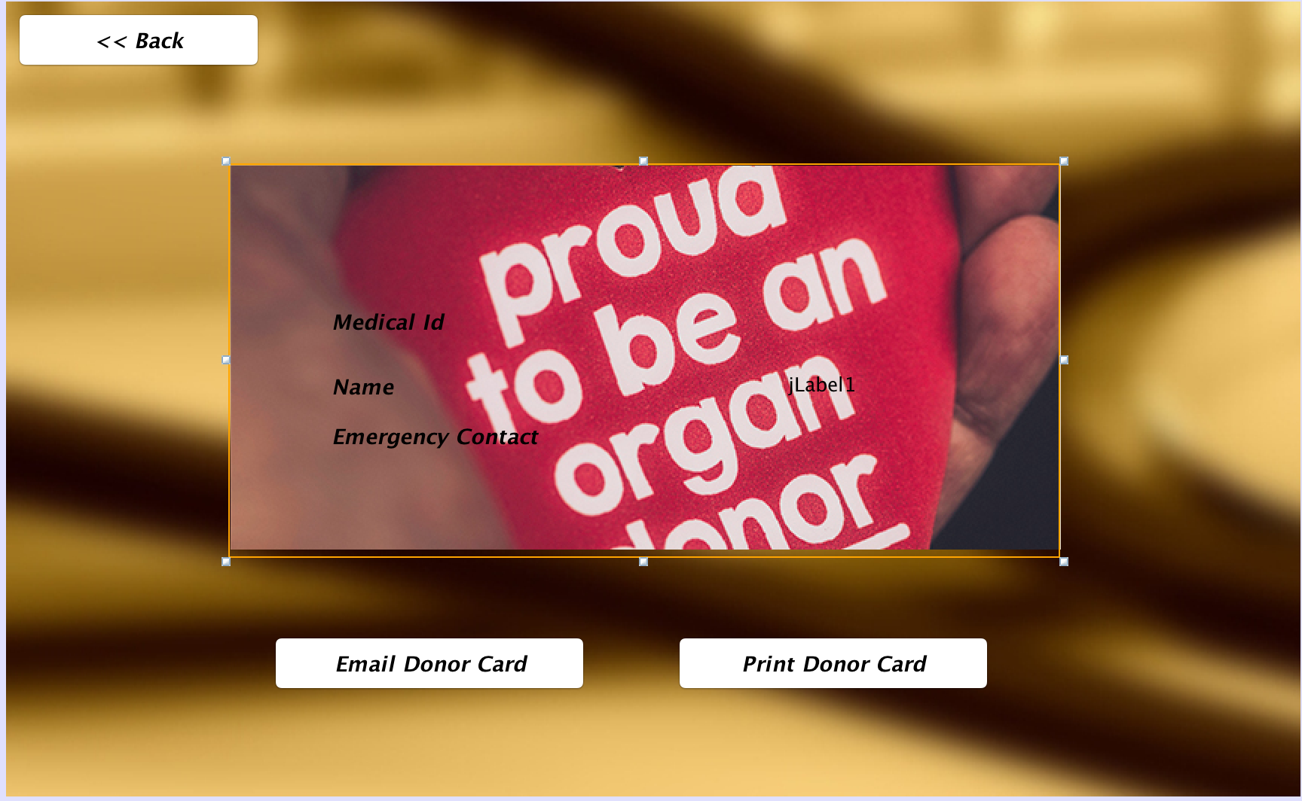
SCREEN SHOTS
Donor Card

Slide 9
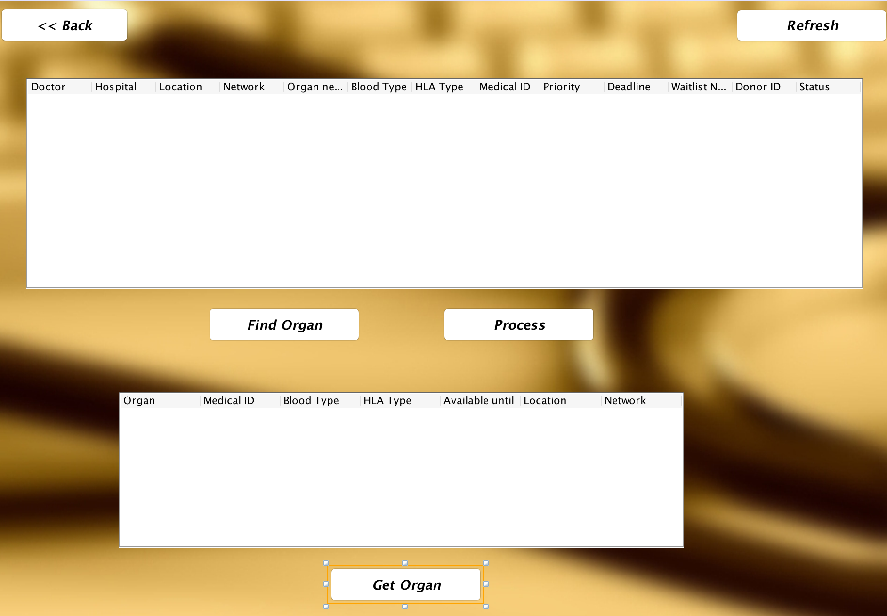
SCREEN SHOTS
Organ Lookout

Slide 10

SCREEN SHOTS
Blood Bank Registration

Slide 11
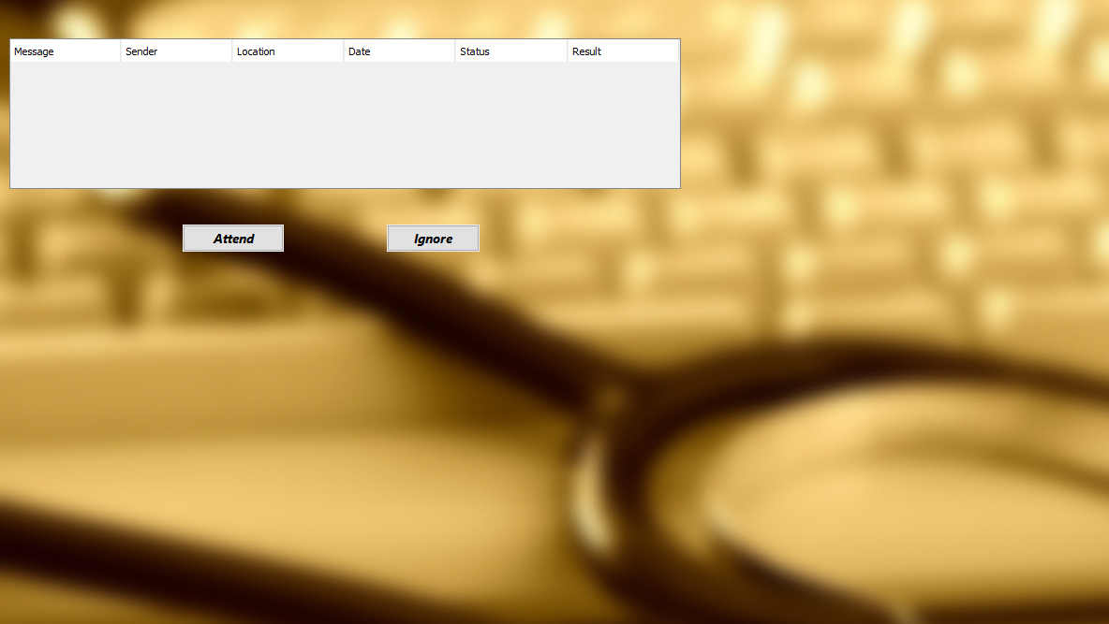
SCREEN SHOTS
Requests from Blood Bank

Slide 12

SCREEN SHOTS
Campaign set-up

Slide 13
DEMO
(Best features)

Slide 14


